Slide 1


Ajisa Muthayil Ali
18/08/2023

Slide 2

Outline
Executive Summary
Introduction
Methodology
Results
Conclusion
Appendix

Slide 3
Executive Summary
Summary of methodologies
Data collection using requests to the Request to the SpaceX API and cleaning data.
Web scarping using BeautifulSoup.
Exploratory data analysis (EDA) visualisation analysis using Pandas and Matplotlib
EDA using SQL
Interactive visual analytics using Dashboard with Plotly Dash and Folium.
Predictive analysis using Machine learning algorithms.
Summary of all results
Exploratory data analysis results
Interactive analytical results
Predictive analysis results

Slide 4
Introduction
Project background and context
Space-X-Falcon-9-First-Stage-Landing-Prediction Space X advertises Falcon 9 rocket launches on its website with a cost of 62 million dollars; other providers cost upward of 165 million dollars each, much of the savings is because Space X can reuse the first stage. The aim of this project is to predict if the first stage will land so that we can determine the cost of a launch. This information can be used if an alternate company wants to bid against space X for a rocket launch.
Problems you want to find answers
To assess main characteristics of the successful or failed landing.
To find if there is any correlation between rockets variables with successful and or failed landing.
To better understand the conditions favor SpaceX to achieve successful landing.

Slide 5

Section 1

Slide 6
Methodology
Executive Summary
Data collection methodology:
SpaceX REST API.
Webscraping from Wikipedia.
Perform data wrangling
Dropping not applicable columns.
One hot encoding to classify models.
Perform exploratory data analysis (EDA) using visualization and SQL
Perform interactive visual analytics using Folium and Plotly Dash
Perform predictive analysis using classification models
How to build, tune, evaluate classification models

Slide 7
Data Collection
Data sets were collected from SpaceX Rest API and webscraping Wikipedia.
SpaceX API and Wikipedia URL were:
api.spacexdata.com/v4/
https://en.wikipedia.org/wiki/List_of_Falcon_9_and_Falcon_Heavy_launches
SpaceX Rest API call
API returns JSON file
Make DataFrame from JSON
Clean Data and export it
API generated information about booster versions, launch sites/dates, payload mass
Get HTML response from wikipedia
Extract data with BeautifulSoup
Make DataFrame
Extract DataFrame
Webscraping Wikipedia generated information about launches, landings and payload

Slide 8
Data Collection – SpaceX API
Got response from API
spacex_url="https://api.spacexdata.com/v4/launches/past”
response = requests.get(spacex_url)
4. Created Dictionary with Data
5. Created DataFrame
df= pd.DataFrame.from_dict(launch_dict, orient='index')
launch_dict = {'FlightNumber':
(data['flight_number']), 'Date':
(data['date']), 'BoosterVersion':BoosterVersion, 'PayloadMass':PayloadMass, 'Orbit':Orbit, 'LaunchSite':LaunchSite, 'Outcome':Outcome, 'Flights':Flights, 'GridFins':GridFins, 'Reused':Reused, 'Legs':Legs, 'LandingPad':LandingPad, 'Block':Block, 'ReusedCount':ReusedCount, 'Serial':Serial, 'Longitude': Longitude, 'Latitude': Latitude}
2. Converted response into JSON File
response1 = requests.get(static_json_url)
resp_dict = response1.json()
data= pd.json_normalize (resp_dict)
6. Filtered DataFrame
data_falcon9 = data_falcon9 [data_falcon9 ['BoosterVersion'] != 'Falcon 1']
3. Transformed Data
7. Exported to file
getLaunchSite(data)
getPayload(data)
getCoreData(data)
getBoosterVersion(data)
data_falcon9.to_csv('dataset_part_1.csv', index=False)
https://github.com/AjisaMuthayilAli/Space-X-Falcon-9-First-Stage-Landing-Prediction/blob/main/Lab1_DataCollection.ipynb

Slide 9
Data Collection - Scraping
Got response from HTML
response = requests.get(static_url).text
5. Created Dictionary
6. Added data to keys
launch_dict= dict.fromkeys(column_names)
# Remove an irrelvant column
del launch_dict['Date and time ( )’]
# Let's initial the launch_dict with each value to be an empty list launch_dict['Flight No.'] = []
launch_dict['Launch site'] = []
launch_dict['Payload'] = []
launch_dict['Payload mass'] = []
launch_dict['Orbit'] = []
launch_dict['Customer'] = []
launch_dict['Launch outcome'] = []
# Added some new columns
launch_dict['Version Booster']=[]
launch_dict['Booster landing']=[]
launch_dict['Date']=[]
launch_dict['Time']=[]
extracted_row = 0
#Extract each table
for table_number,table in
(soup.find_all('table',"wikitable plainrowheaders collapsible")):
# get table row for rows in table.find_all("tr"):
#check to see if first table heading is as number corresponding to launch a number
if rows.th: if rows.th.string: flight_number=rows.th.string.strip() flag=flight_number.isdigit() else: flag=False
#get table element row=rows.find_all('td') #if it is number save cells in a dictonary if flag: extracted_row += 1
SEE NOTEBOOK FOR THE WHOLE CODE
2. Created BeautifulSoup object
soup = BeautifulSoup(response, 'html.parser')
3. Found all tables
html_tables = soup.find_all("table")
4. Got column names
7. Created DataFrame from Dictionary
temp = soup.find_all('th') for x in ((temp)):
try:
name = extract_column_from_header(temp[x])
if (name is not None and (name) > 0):
column_names.append(name)
except:
pass
df=pd.DataFrame(launch_dict)
https://github.com/AjisaMuthayilAli/Space-X-Falcon-9-First-Stage-Landing-Prediction/blob/main/Lab2_WebScraping.ipynb
8. Exported to file
df.to_csv('spacex_web_scraped.csv', index=False)

Slide 10
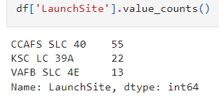
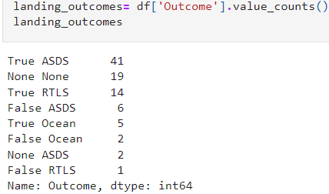
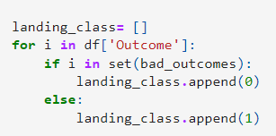
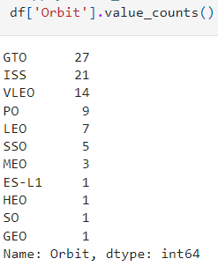
Data Wrangling
In the data set, there are several different cases where the booster did not land successfully. They were represented as categorical variables (False Ocean: unsuccessfully landed into ocean, False RTLS: unsuccessfully landed into ground pad, True RTLS: successfully landed into ground pad, True ASDS: successfully landed into drone ship etc.)
Converted these categorical variables into binary variables using dummies; where 1 means successful mission and 0 means unsuccessful mission.
Calculated number of launches from each launch site
3. Calculated number and occurrence of mission outcome for each orbit type
4.Created landing outcome label from Outcome column
2. Calculated number and occurrence of each orbit
5. Exported to file
df.to_csv(‘dataset_part_2.csv', index=False)
https://github.com/AjisaMuthayilAli/Space-X-Falcon-9-First-Stage-Landing-Prediction/blob/main/Lab3_DataWrangling.ipynb

Slide 11
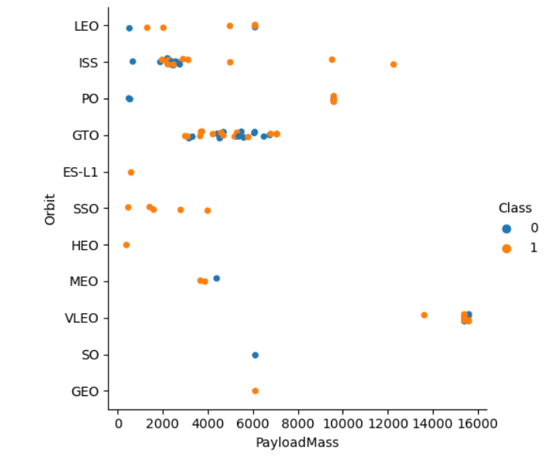
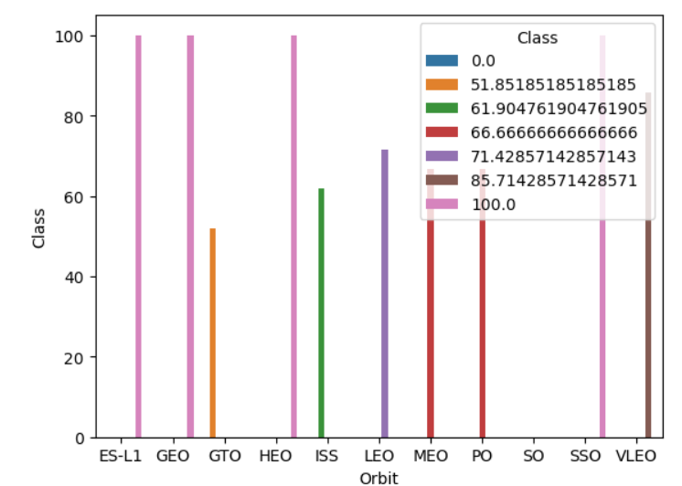
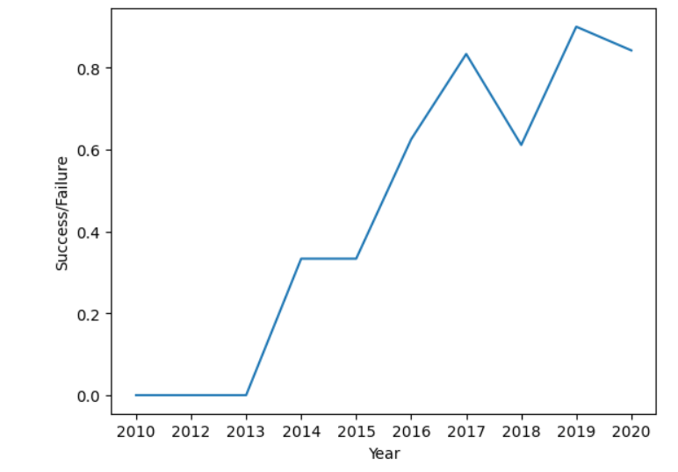
EDA with Data Visualization
Scatter graphs to show the correlation between variables
Flight Number vs PayLoad Mass
Flight Number vs Launch Site
Payload vs Launch Site
Orbit vs Flight Number
Payload vs Orbit Type
Orbit vs Payload Mass
Bar plot to show the relation between categorical and numerical variables
Line chart to show the trend
https://github.com/AjisaMuthayilAli/Space-X-Falcon-9-First-Stage-Landing-Prediction/blob/main/Lab5_EDA_DataVisualisation.ipynb
A
B
C

Slide 12
EDA with SQL
Displayed the names of the unique launch sites in the space mission.
Displayed 5 records where launch sites begin with the string 'CCA’.
Displayed the total payload mass carried by boosters launched by NASA (CRS).
Displayed average payload mass carried by booster version F9 v1.1.
Listed the names of the boosters which have success in drone ship and have payload mass greater than 4000 but less than 6000.
Listed the total number of successful and failure mission outcomes
Listed the names of the booster_versions which have carried the maximum payload mass.
Listed the records which will display the month names, failure landing_outcomes in drone ship ,booster versions, launch_site for the months in year 2015.
Ranked the count of landing outcomes (such as Failure (drone ship) or Success (ground pad)) between the date 2010-06-04 and 2017-03-20, in descending order.
https://github.com/AjisaMuthayilAli/Space-X-Falcon-9-First-Stage-Landing-Prediction/blob/main/Lab4_ExploratoryDataAnalysisUsingSQL.ipynb

Slide 13
Build an Interactive Map with Folium
Created a folium map object centered around NASA Johnson Center at Houston, Texas.
Blue circle showing NASA Johnson Space Center’s name.
Red circle shows the launch site names.
Green marker shows successful mission and red marker shows unsuccessful mission.
Markers shows the distance between launch sites to key locations such as railway, highway, city etc.
This map aided to better understand if the geographical locations and or surroundings has any effect on the mission outcome.
https://github.com/AjisaMuthayilAli/Space-X-Falcon-9-First-Stage-Landing-Prediction/blob/main/Lab6_Launch%20SitesLocationsAnalysiswithFolium.ipynb

Slide 14
Build a Dashboard with Plotly Dash
Dashboard included drop down, pie and scatter plots.
Drop down: to choose launch sites.
Pie chart: shows the successful and unsuccessful missions.
Scatter plot: correlation between variables such as payload mass vs successful landing.
https://github.com/AjisaMuthayilAli/Space-X-Falcon-9-First-Stage-Landing-Prediction/blob/main/Lab7_DashboardinteractiveappwithPlotlyDash.ipynb

Slide 15
Predictive Analysis (Classification)
Data preparation: Loaded, Normalised and split train/test datasets.
Model preparation: selected ML algorithms, set parameters for each type of model and trained with training sets.
Model Evaluation: chose best paraments for each model, computed accuracy for each model using test dataset and plotted confusion matrix.
Model comparison: Compared models based on their accuracy and the model with the best accuracy was chosen.
https://github.com/AjisaMuthayilAli/Space-X-Falcon-9-First-Stage-Landing-Prediction/blob/main/Lab8_Machine%20Learning%20Prediction.ipynb

Slide 16
Results
SVM, KNN and Logistic regression models west best in terms of prediction accuracy.
The success rates of spaceX launches is directly proportional to time in years.
KSC LC 39A had the most successful launches from all sites.
Orbit GEO, HEO, SSO, ES L1 has the best success rate

Slide 17

Section 2

Slide 18
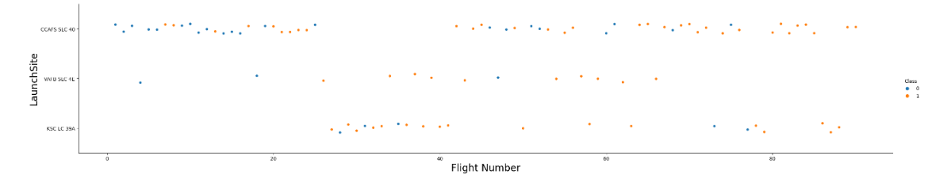
Flight Number vs. Launch Site
Success rate (orange data points) is increasing at all launch sites.

Slide 19
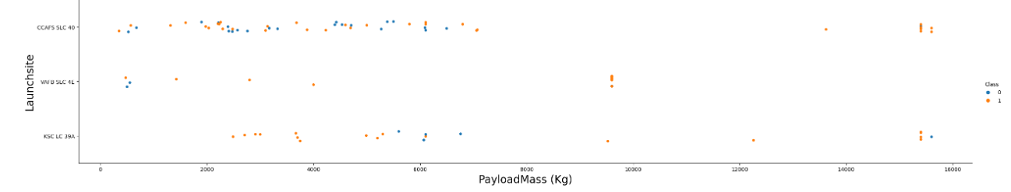
Payload vs. Launch Site
Success rate is higher with higher payload mass.

Slide 20
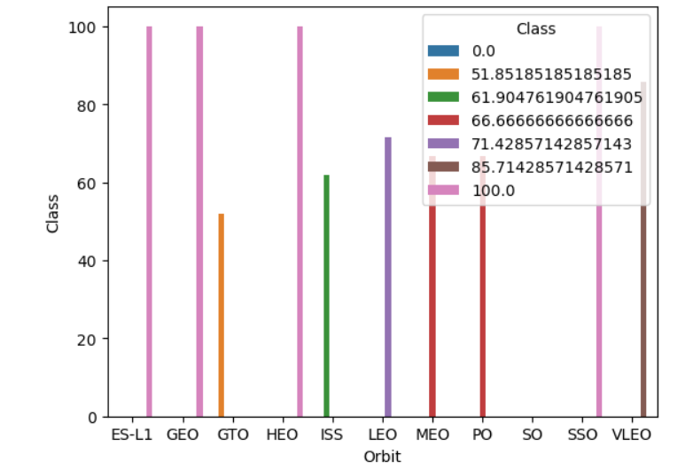
Success Rate vs. Orbit Type
Success rate us higher for SD-L1, GEO, HEO, SSO

Slide 21
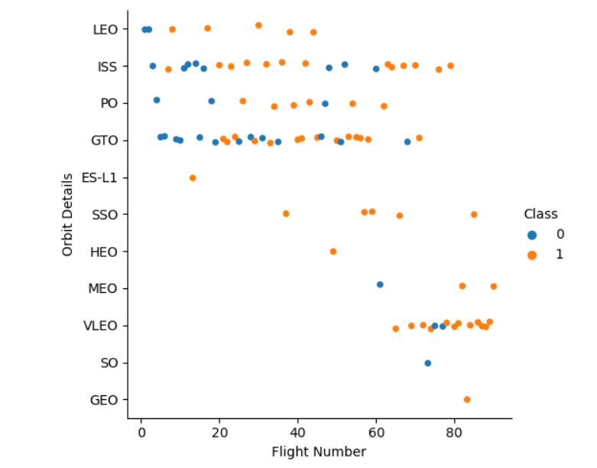
Flight Number vs. Orbit Type
Success rate increases with the number of flights for LEO, ISS, PO and GTO.
Doesn’t correlate success rate with VLEO, SSO orbits as the flight number increases.

Slide 22
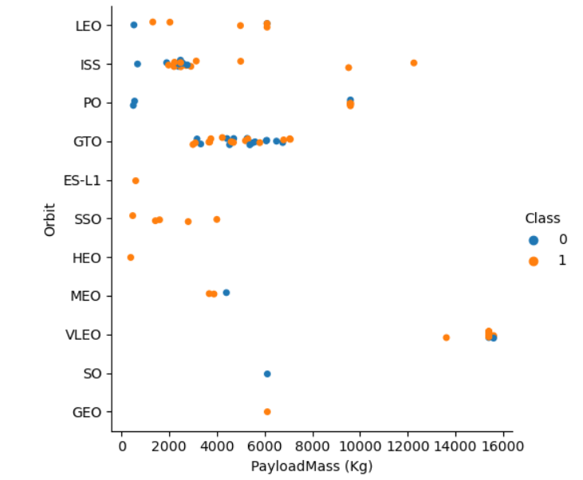
Payload vs. Orbit Type
Success rate increases with payload mass for certain orbits (ISS, LEO)
Conversely, the success rate decreased with payload mass for GTO.

Slide 23
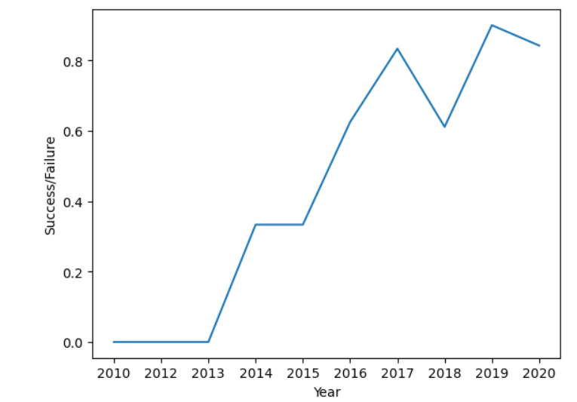
Launch Success Yearly Trend
Success rate increased since 2013 until 2020.

Slide 24
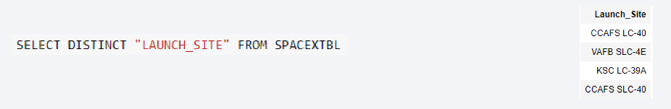
All Launch Site Names
Distinct query removed duplicate attributes (LAUNCH_SITE)

Slide 25
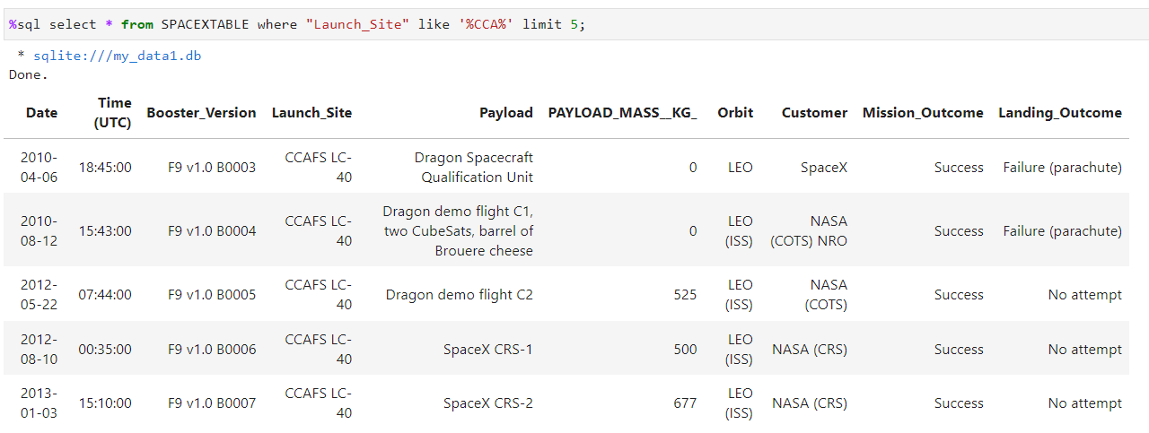
Launch Site Names Begin with 'CCA'
Like function aids to sub-filter with part of the word.
Limit (5) function limits the rows to 5.

Slide 26
Total Payload Mass
The total payload mass for NASA (CRS) is 45596 kg.

Slide 27
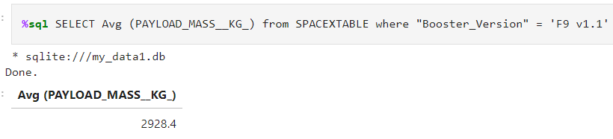
Average Payload Mass by F9 v1.1
Average payload mass carried by booster version F9 v1.1 is 2928.4 kg

Slide 28
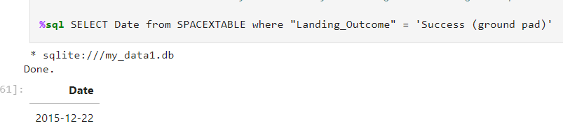
First Successful Ground Landing Date
The first successful landing on ground pad was made on 22nd December 2015.

Slide 29
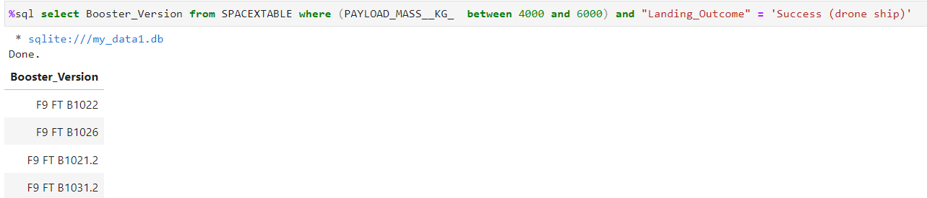
Successful Drone Ship Landing with Payload between 4000 and 6000
We can filter payload mass and limit specific weight with between and function.

Slide 30
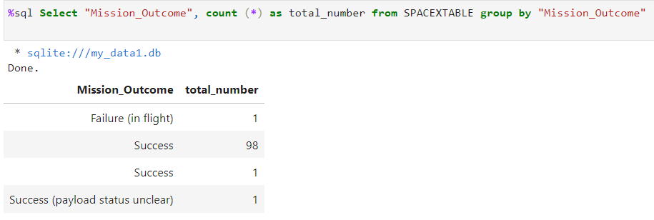
Total Number of Successful and Failure Mission Outcomes
Group by can be used to separate groups within a column and count function can be used to get total sum of each group.

Slide 31
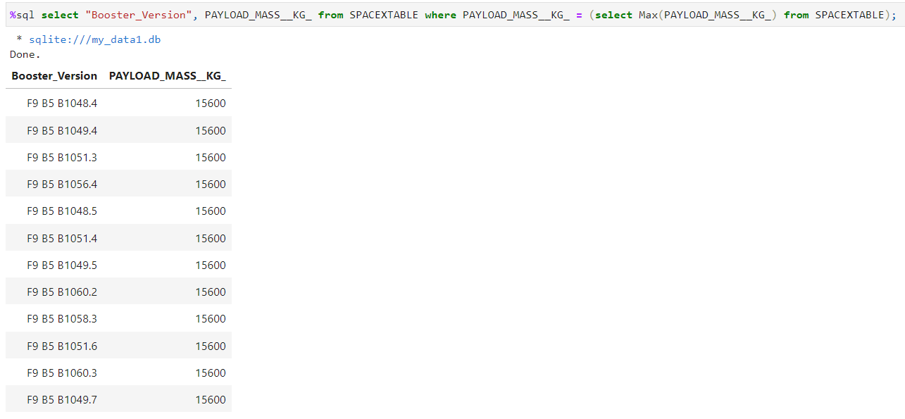
Boosters Carried Maximum Payload
Subquery can be used to filter maximum value of an observation (Payload mass) for a booster version.

Slide 32
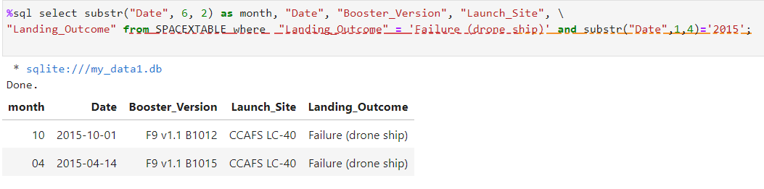
2015 Launch Records
Can sub-filter Date and specify the character position and length and saved using ‘as’ in a new column.
Year sub-filtered using (1,4) where 1 is the position of year starting character and 4 is the total number of characters need to filter (i.e. 2015).

Slide 33
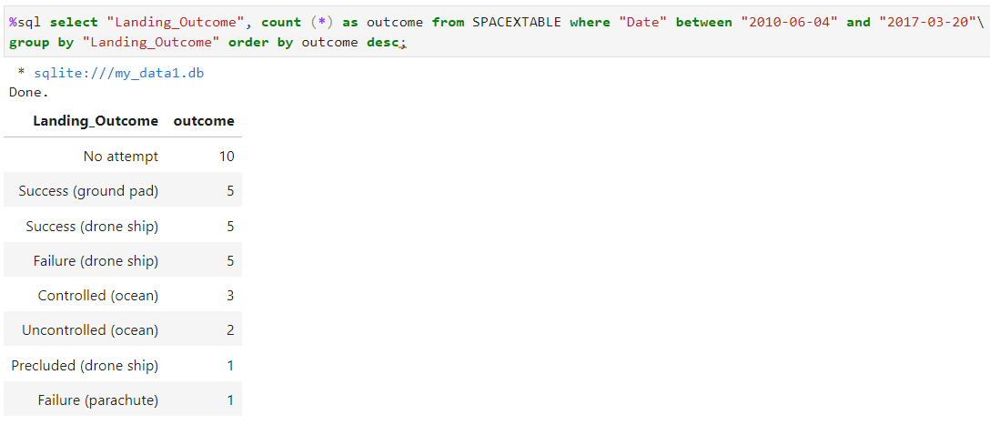
Rank Landing Outcomes Between 2010-06-04 and 2017-03-20
Specific dates were sub-filtered from a column (Date), counted total number using ‘count’ and ordered using ‘order’.
‘desc’ function helps to order in descending order.

Slide 34

Section 3

Slide 35
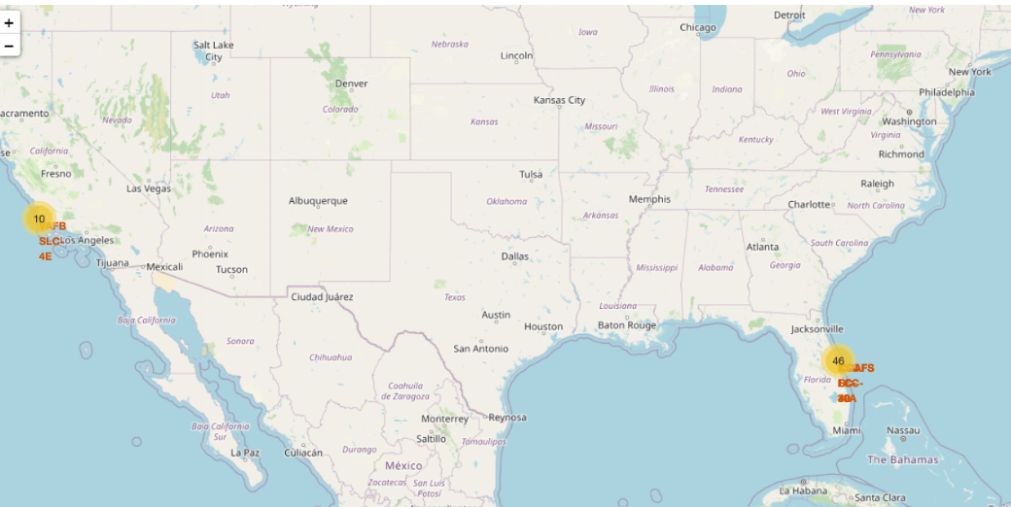
Folium Map
Launch sites are clearly marked

Slide 36
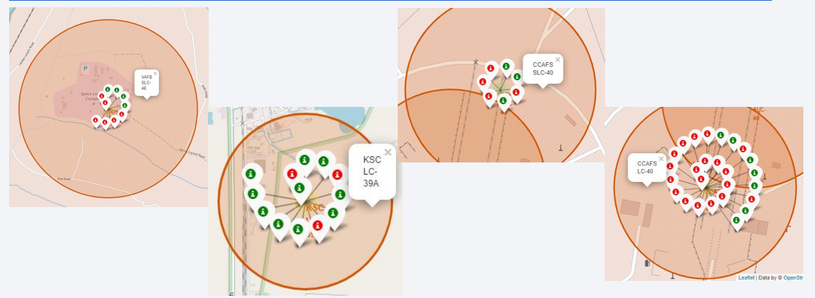
Folium Map: Markers
Green represents successful and red represents unsuccessful missions.
KSC LC-39A has the highest success rate.

Slide 37
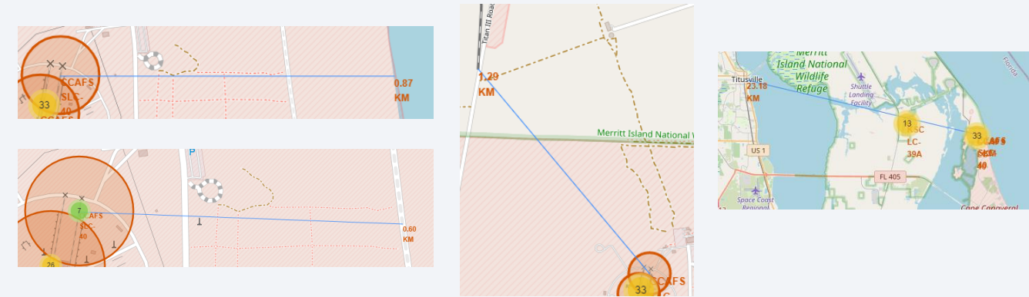
Folium Map: distance between CCAFS SLC-40 and its proximities
CCAFS SLC-40 is close to railways, highways, coastline and city: Yes

Slide 38

Section 4

Slide 39
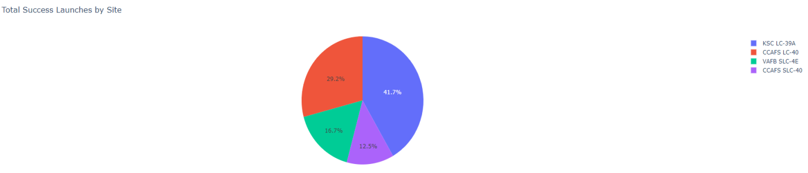
Dashboard: Total success grouped by launch sites
KSC LC 39A has the highest success rate

Slide 40
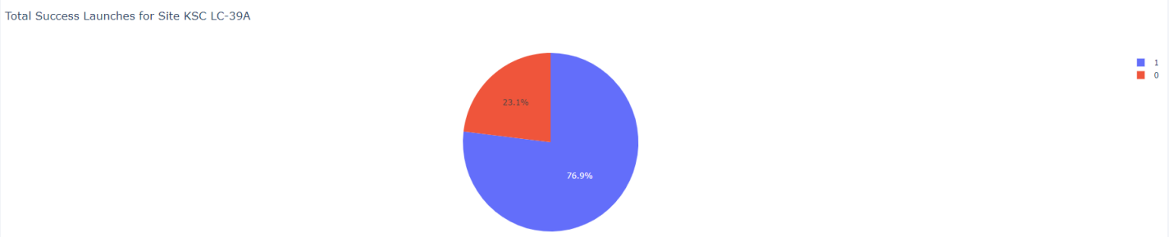
Dashboard: success rate breakdown of KSC LC-39A site
KSC LC-39A has a breakdown of 76.9% successful missions and 23.1% failure rate.

Slide 41
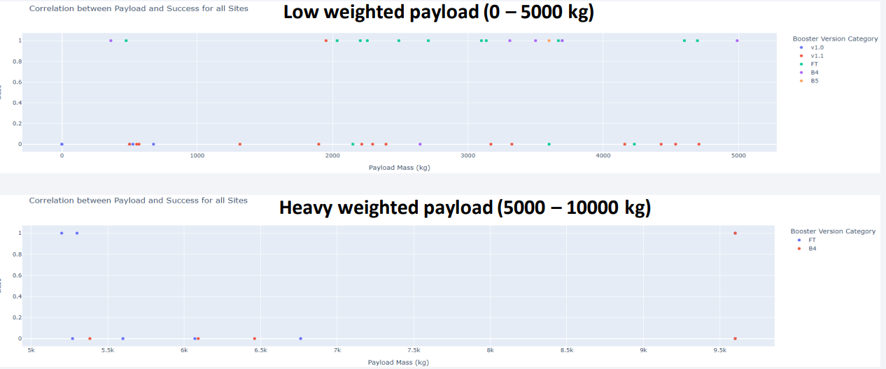
Dashboard: Payload Mass vs outcome.
Low payload mass has better success rate.

Slide 42

Section 5

Slide 43
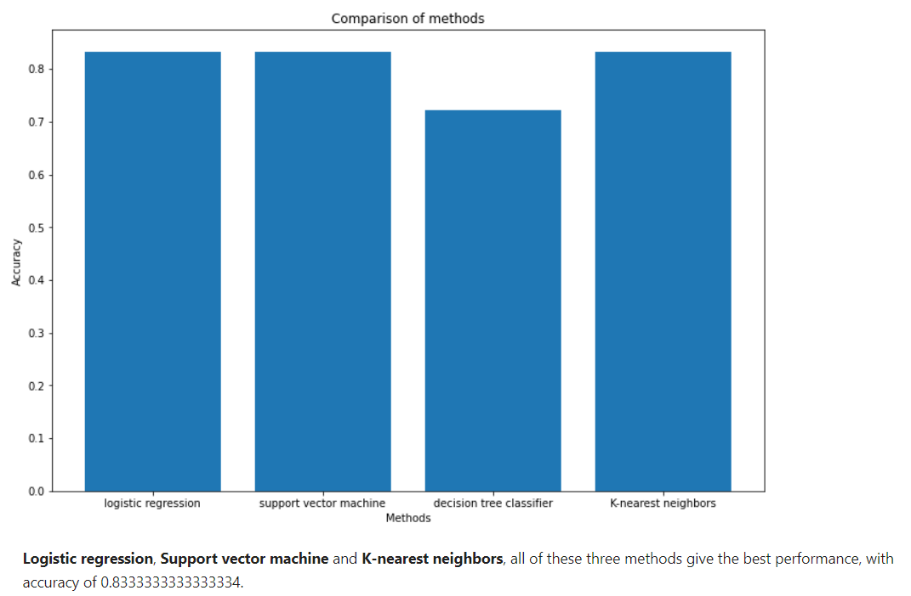
Classification accuracy
Decision tree model has the lowest accuracy.
Logistic regression, SVM and KNN show similar accuracy.

Slide 44
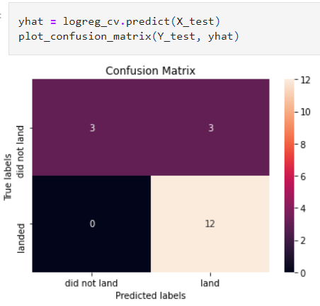
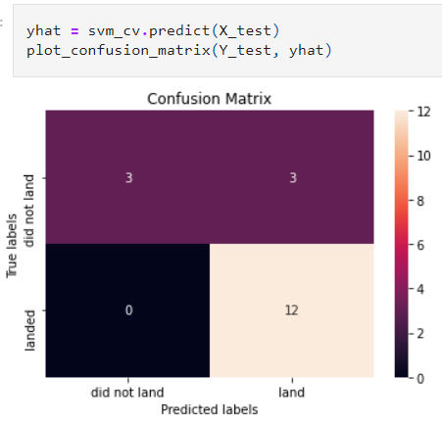
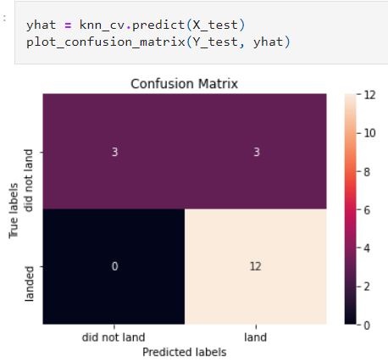
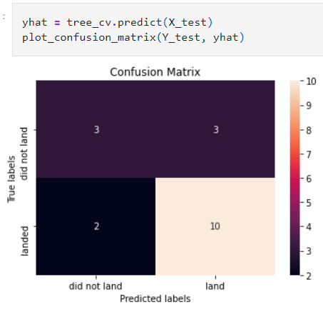
Confusion Matrix
Confusion matrix is same for Logistic regression, SVM and KNN.
Decision tree model has lower number of True Negatives.

Slide 45
Conclusions
Success rate of a mission does vary with variables such as Launch site, payload mass, orbit and number of launches.
Orbits with highest success rate are GEO, HEO, SSO, ES-L1.
Some orbits showed better success rate with heavier payload and vice-versa.
KNN, Logistic regression and SVM showed highest accuracy and therefore any of these models can be used.

Slide 46
Appendix
https://github.com/AjisaMuthayilAli/Space-X-Falcon-9-First-Stage-Landing-Prediction

Slide 47


